Slide 1
NUMERICAL ANALYSIS OF ORDINARY DIFFERENTIAL EQUATIONS
Euler’s Method, Heun’s Method & Midpoint Method
COURSE: CSE261 – NUMERICAL METHODS
SECTION: ALL SECTIONS

Slide 2

NUMERICAL ANALYSIS OF ODES: ACCURACY AND CONVERGENCE
TOPIC: NUMERICAL ANALYSIS OF ORDINARY DIFFERENTIAL EQUATIONS
This presentation delves into the intricacies of numerical methods, with a particular focus on their accuracy and convergence properties when applied to Ordinary Differential Equations (ODEs).
STUDENT NAME STUDENT ID
TAREK HOSSIAN 2024100000382
NURA NUSRAT JANNAT 2024000000320
PRITOM CHOWDHURY 2024000000007
MUNTAHA HASNAT PRIONTY 2024000000033
MESBAH UDDIN MOLLA 2024000000105
SUMAIYA AKTER MIM 2024100000265
ASIFUR RAHMAN ASIF 2024000000330
RIYAD UZ ZAMAN 2024000000231
TAWFIQ AL IBAD 2024000000068
MAHJABEEN TUR 2024200000319
Presented by

Slide 3

01.
Real world Systems
Many phenomena in engineering, physics, and biology are elegantly described using Ordinary Differential Equations. From population dynamics to circuit analysis, ODEs are fundamental.
02.
Analytical Limitations
While ODEs are powerful, finding exact analytical solutions is often impossible or highly complex. This necessitates alternative approaches.
INTRODUCTION TO NUMERICAL SOLUTIONS
Approximating Solutions
Numerical methods provide a powerful tool to approximate solutions to ODEs step-by-step, transforming continuous problems into discrete computations
03.
Comparative Analysis
Our primary goal is to compare the accuracy and efficiency of different numerical methods, highlighting their strengths and weaknesses in various scenarios.
04.

Slide 4
WHY NUMERICAL METHODS MATTER
In the intricate world of engineering and computer science, many real-world systems defy elegant analytical solutions. This is precisely where numerical methods become indispensable, offering powerful tools to approximate solutions where exact formulas fall short.
APPLICATIONS ACROSS DISCIPLINES
POPULATION GROWTH MODELS
Predicting future demographics and resource allocation relies heavily on numerical approximations

Slide 5
HEAT TRANSFER
Modelling temperature distribution in materials for design and safety applications benefits from numerical simulations.
ENGINEERING SIMULATIONS
From structural analysis to fluid dynamics, numerical methods are the backbone of modern engineering design.

Slide 6
DEFINING THE INITIAL VALUE PROBLEM
Methods Under Comparison
To achieve this, we will rigorously evaluate three distinct numerical techniques:
  Euler’s Method: The foundational explicit method, known for its simplicity.
  Heun’s Method: A more refined predictor-corrector approach, offering improved accuracy.
  Midpoint Method: Another second-order method that estimates the slope at the interval's midpoint.

Slide 7
THE CORE PROBLEM
We consider the Initial Value Problem (IVP), defined by a first-order ordinary differential equation and an initial condition:
dy/dt=f(t,y),y(t0​)=y0​
Our objective is to accurately approximate the value of y over a specified time interval, given its initial state.

Slide 8

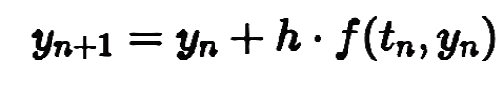
EULER’S METHOD: THE FUNDAMENTALS
01.
First-Order Approach
03.
Advantages
Euler's Method is the most basic explicit numerical integration technique for solving ordinary differential equations. It approximates the next point on a curve using the tangent at the current point.
  Remarkably simple to understand and implement.
  Requires minimal computational resources per step.
02.
Mathematical Formula
04.
Disadvantages
  Relatively large local truncation error, typically O(h²).
  Errors accumulate significantly, leading to poor global accuracy O(h), especially with larger step sizes or longer integration intervals.
Where h is the step size, y_n is the approximation at t_n, and f(t_n, y_n) is the derivative.

Slide 9

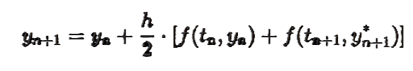
HEUN’S METHOD: ENHANCED ACCURACY
PREDICTOR STEP
First, we use Euler's method to predict an initial estimate for the next value, y*n+1
CORRECTOR STEP
Next, we refine this prediction by averaging the slopes at the beginning and predicted end of the interval.

Slide 10
ACCURACY
Heun's Method is a second-order method, meaning its local truncation error is O(h³), resulting in a global error of O(h²).
This predictor-corrector approach makes Heun’s Method significantly more stable and accurate than the basic Euler’s Method, especially for problems requiring higher precision.

Slide 11
MIDPOINT METHOD: THE CENTRAL APPROXIMATION
SECOND-ORDER NUMERICAL METHOD
The Midpoint Method, also known as the modified Euler method, is another effective second-order numerical technique for approximating solutions to ODEs.
Its key innovation lies in using the slope evaluated at the midpoint of the interval, rather than just the beginning or end points, leading to improved accuracy.

Slide 12

FORMULA FOR APPROXIMATION
This formula effectively approximates the function value at the midpoint (t_n + h/2) to get a better estimate of the average slope over the interval.
Similar to Heun's Method, the Midpoint Method yields a global error of O(h²), consistently providing a more accurate approximation than Euler’s Method for a given step size.

Slide 13
IMPLEMENTATION DETAILS INC++
Our numerical ODE solver was developed using robust C++ programming, focusing on modularity and clear data handling for effective analysis.
Modular System: We designed a flexible C++ system, utilizing std::vector for efficient data storage and dynamic resizing, and std::ofstream for exporting results to CSV format, enabling easy plotting and analysis.
Core Logic: The heart of the solver is a time-stepping loop. In each iteration, time t is updated by adding the step size h, and the function value y is updated based on the specific numerical algorithm (Euler, Heun, or Midpoint) being applied.
Validation: To rigorously assess the accuracy of each method, we simultaneously computed the "Exact Solution" at every time step. This allowed us to precisely measure the true Global Error accumulated by each numerical approximation.

Slide 14
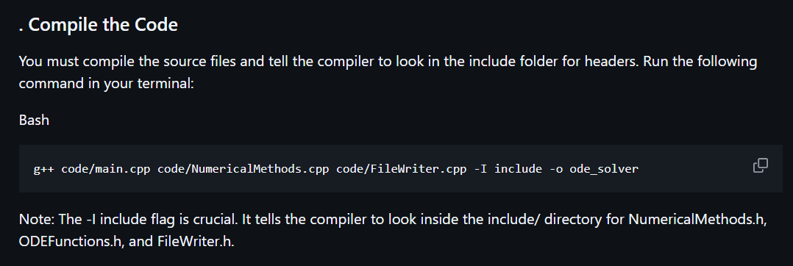


Slide 15
NUMERICAL EXPERIMENT SETUP
To compare the numerical methods, we established a controlled experiment using a well-known differential equation with an available analytical solution.
Test ODE: We chose the linear first-order ODE: y^2 = y 2 t^2 + 1. This equation provides a challenging yet tractable test case for our numerical solvers.
CONDITIONS:
Domain: We integrated the ODE over the interval 0 f t f 2.
Initial Condition: A precise starting point was set at y(0) = 0.5.
Step Size: A consistent step size of h = 0.1 was used across all methods for direct comparison.
Reference: The exact solution for this ODE, y(t) = (t + 1)^2 2 0.5e^t, served as our ground truth for error calculation and accuracy validation.

Slide 16
NUMERICAL EXPERIMENTS & RESULTS ANALYSIS
TEST PROBLEM DEFINED
We employed a specific initial value problem to evaluate the performance of each method:
y’ = y- t^2 + 1
y(0) = 0.5
With a consistent step size of h = . across all experiments, allowing for a fair comparison of accuracy

Slide 17
KEY FINDINGS
EULER’S METHOD:
Demonstrated a noticeable deviation from the exact solution, highlighting its lower accuracy.
HEUN’S & MIDPOINT METHODS:
Showed excellent agreement with the exact solution, closely tracking its behaviour.
ERROR CONVERGENCE:
Confirmed that both Heun's and the Midpoint Method exhibited O(h²) convergence, as theoretically predicted

Slide 18
CONCLUSION & RECOMMENDATIONS
EULER’S METHOD
Simple to implement but sacrifices accuracy. It's generally not recommended for problems requiring high precision due to its O(h) global error.
HEUN’S & MIDPOINT
Both methods offer significantly improved accuracy and stability with a global error of O(h²), making them suitable for a broader range of applications.
FASTER CONVERGENCE
Second-order methods like Heun9s and Midpoint converge much faster to the true solution as the step size (h) decreases, providing reliable results efficiently
RECOMMENDATION
For most practical problems where a balance between implementation complexity and accuracy is needed, Heun’s Method is often recommended due to its robustness and improved performance over Euler's Method.

Slide 19
THANK
YOU.

